Slide 1

Algebra 1
Unit 5, Lesson 3 Interpreting Equations Volume 1, pg. 240

Slide 2


Benchmarks
MA.912.AR.2.1
Given a real-world context, write and solve one-variable multi-step linear equations.
MA.912.AR.1.2
Rearrange equations or formulas to isolate a quantity of interest.
MA.912.AR.9.6
Given a real-world context, represent constraints as systems of linear equations or inequalities. Interpret solutions to problems as viable or non-viable options.
volume 1, pg. 240

Slide 3
Integrated Mathematical Thinking and Reasoning Standards
MA.K12.MTR.2.1 Demonstrate understanding by representing problems in multiple ways.
MA.K12.MTR.4.1 Engage in discussions that reflect on the mathematical thinking of self and others.
MA.K12.MTR.5.1 Use patterns and structure to help understand and connect mathematical concepts.
MA.K12.MTR.7.1 Apply mathematics to real-world contexts.
volume 1, pg. 240

Slide 4

Learning Targets
I can define variables in a real-world context.
I can interpret equations and their parts in a given context.
volume 1, pg. 240

Slide 5

Warm-Up
volume 1, pg. 240

Slide 6
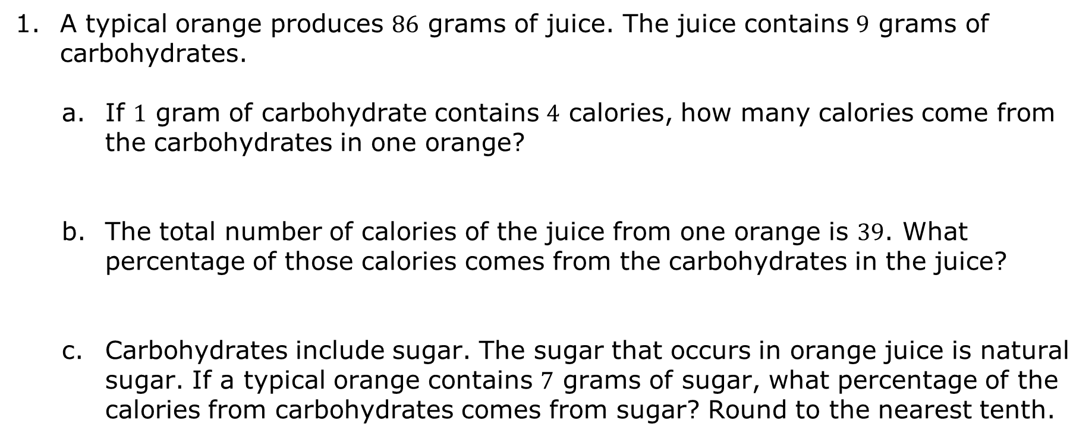
5.3.1 Warm-Up: Orange Juice
A typical orange produces $86$ grams of juice. The juice contains $9$ grams of carbohydrates.
If $1$ gram of carbohydrate contains $4$ calories, how many calories come from the carbohydrates in one orange?
The total number of calories of the juice from one orange is $39$. What percentage of those calories comes from the carbohydrates in the juice?
Carbohydrates include sugar. The sugar that occurs in orange juice is natural sugar. If a typical orange contains $7$ grams of sugar, what percentage of the calories from carbohydrates comes from sugar? Round to the nearest tenth.
volume 1, pg. 240

Slide 7

Guided Instruction
volume 1, pg. 241

Slide 8



5.3.2 Guided Instruction: What is a Parameter?
In the expression $4x$, the $4$ is the coefficient and the $x$ is the variable. The expression $4x$ could be used to represent the number of calories in orange juice that comes from carbohydrates since $1$ gram of carbohydrate contains $4$ calories.
In the expression $4x$, what is the parameter?
A parameter is a quantity that influences the output.
volume 1, pg. 241

Slide 9
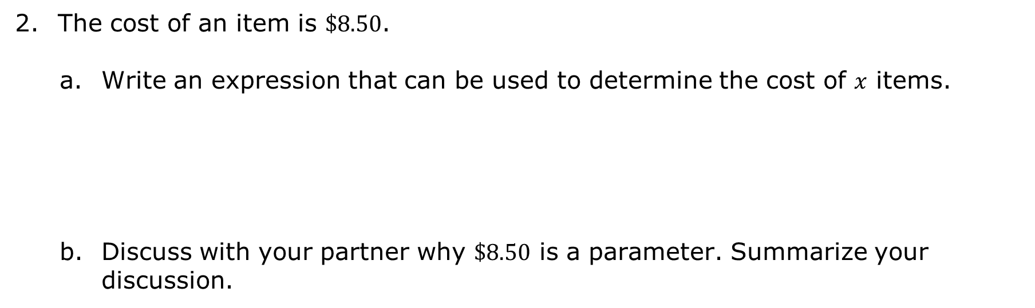
The cost of an item is $\$8.50$.
Write an expression that can be used to determine the cost of $x$ items.
Discuss with your partner why $\$8.50$ is a parameter. Summarize your discussion.
volume 1, pg. 241

Slide 10
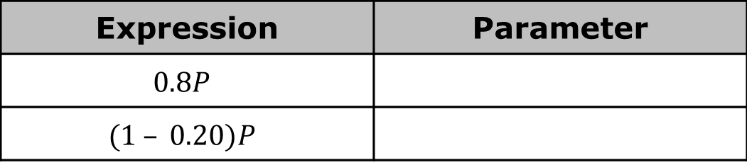
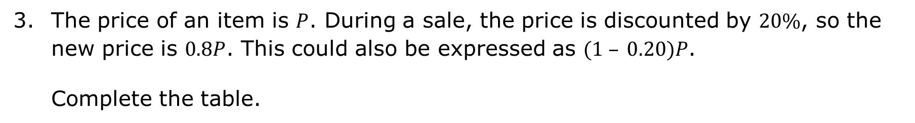
The price of an item is $P$. During a sale, the price is discounted by $20\%$, so the new price is $0.8P$. This could also be expressed as $(1 – 0.20)P$.
Complete the table.
Expression | Parameter
$$0.8P$$
$$(1 – 0.20)P$$
volume 1, pg. 241

Slide 11
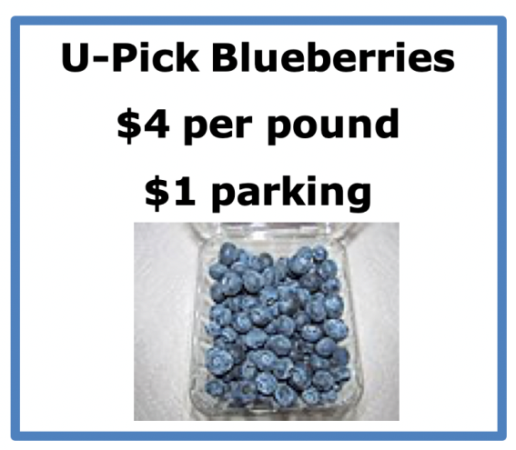
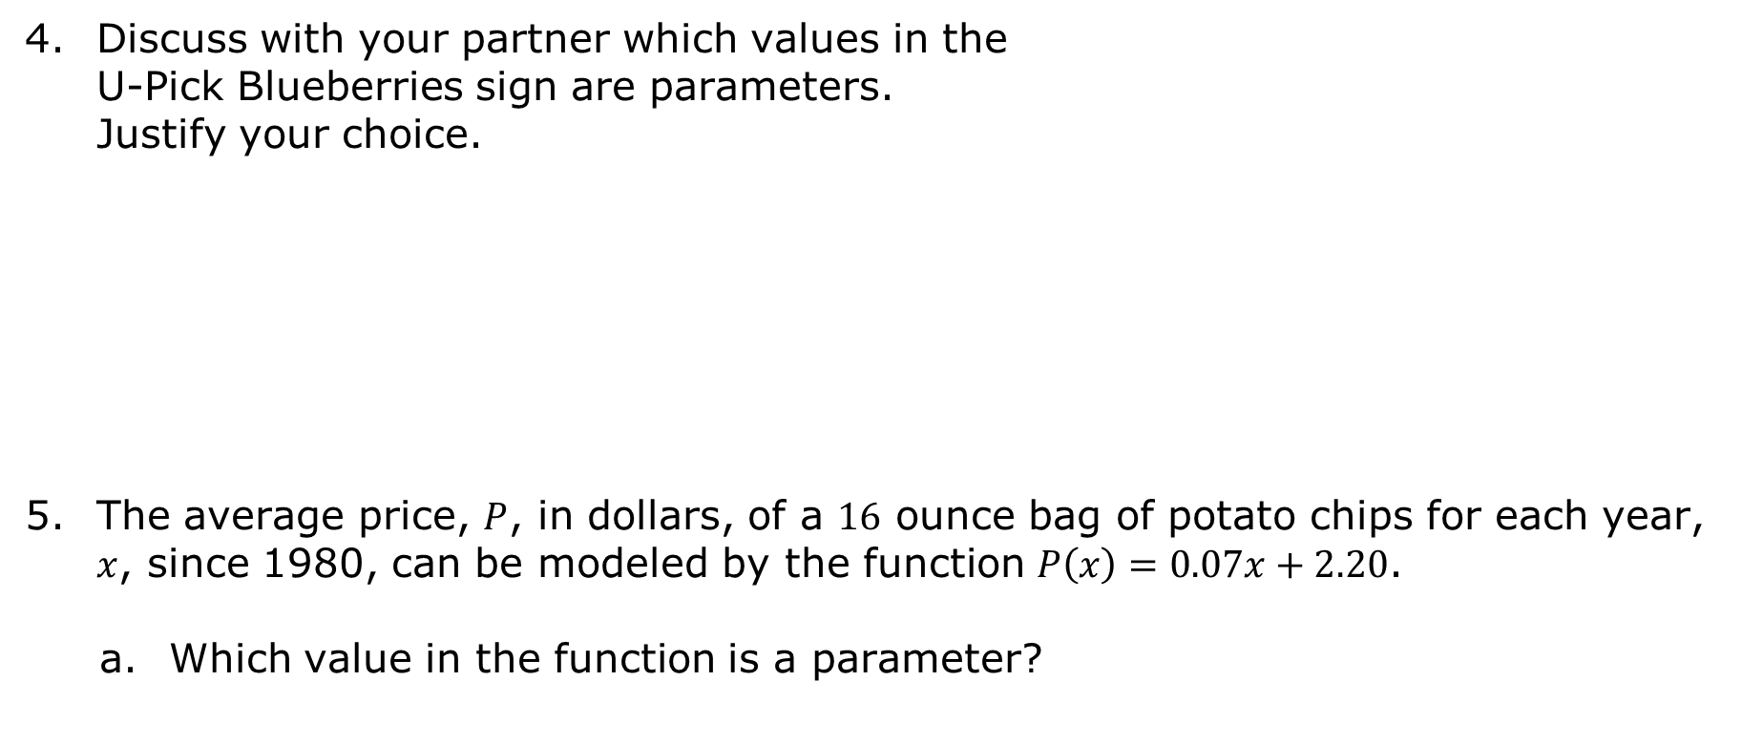
Discuss with your partner which values in the U-Pick Blueberries sign are parameters. Justify your choice.
The average price, $P$, in dollars, of a $16$ ounce bag of potato chips for each year, $x$, since 1980, can be modeled by the function $P\left(x\right)=0.07x+2.20$.
Which value in the function is a parameter?
volume 1, pg. 241

Slide 12
What does the value 2.20 mean in terms of the price of potato chips?
What does the value 0.07 mean in terms of the price of potato chips?
volume 1, pg. 242

Slide 13
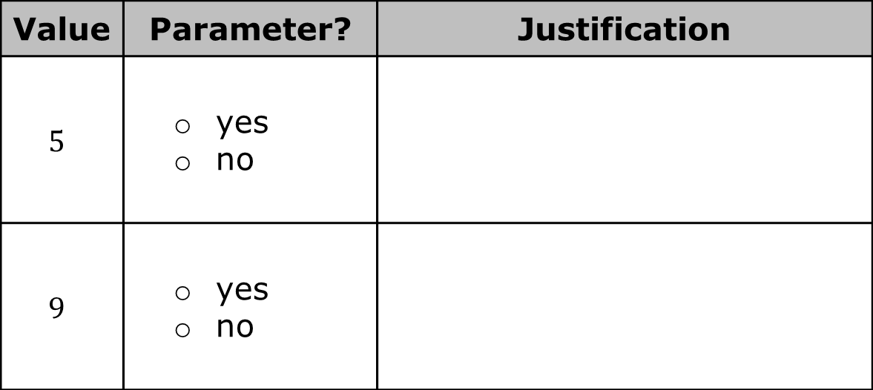
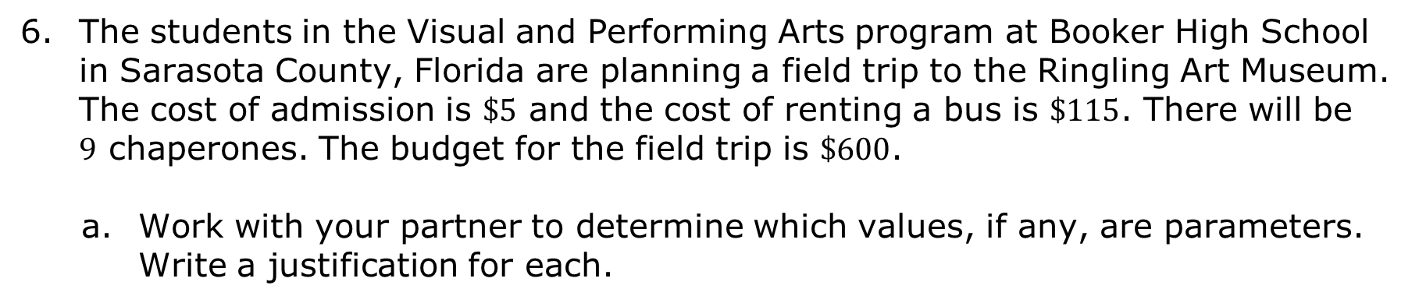
The students in the Visual and Performing Arts program at Booker High School in Sarasota County, Florida are planning a field trip to the Ringling Art Museum. The cost of admission is $\$5$ and the cost of renting a bus is $\$115$. There will be $9$ chaperones. The budget for the field trip is $\$600$.
Work with your partner to determine which values, if any, are parameters. Write a justification for each.
Value | Parameter? | Justification
$$5$$ | yes no
$$9$$ | yes no
volume 1, pg. 242

Slide 14


Use the values to complete the equation that can be used to find the number of students, $x$, who can go on the field trip.
$$________\left(x+________\right)+________=________$$
Value | Parameter? | Justification
$$115$$ | yes no
$$600$$ | yes no
volume 1, pg. 242

Slide 15

Activity
volume 1, pg. 243

Slide 16

5.3.3 Activity: Card Sort
Work with your partner to sort the cards provided by your teacher.
Record the two lowercase letters on the card that matches the meaning of each value.
volume 1, pg. 243

Slide 17
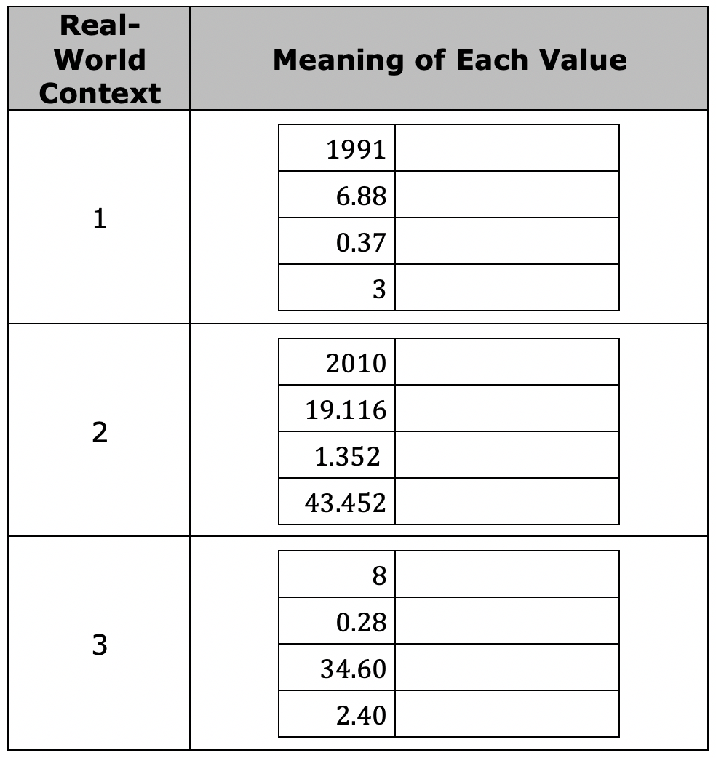
volume 1, pg. 243

Slide 18
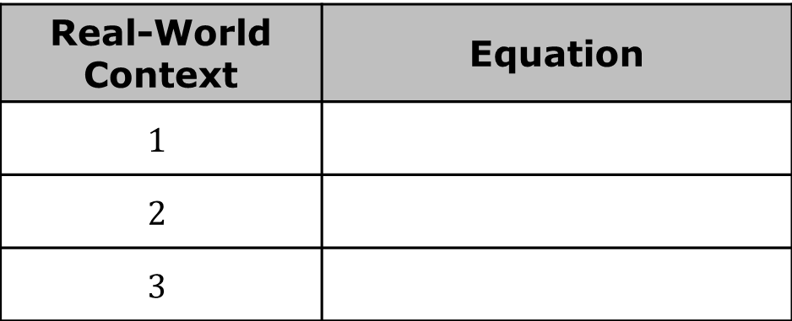
Record the letter and the equation that matches the context for each scenario.
Real-World Context | Equation
$$1$$
$$2$$
$$3$$
volume 1, pg. 243

Slide 19

Wrap-Up
volume 1, pg. 243

Slide 20
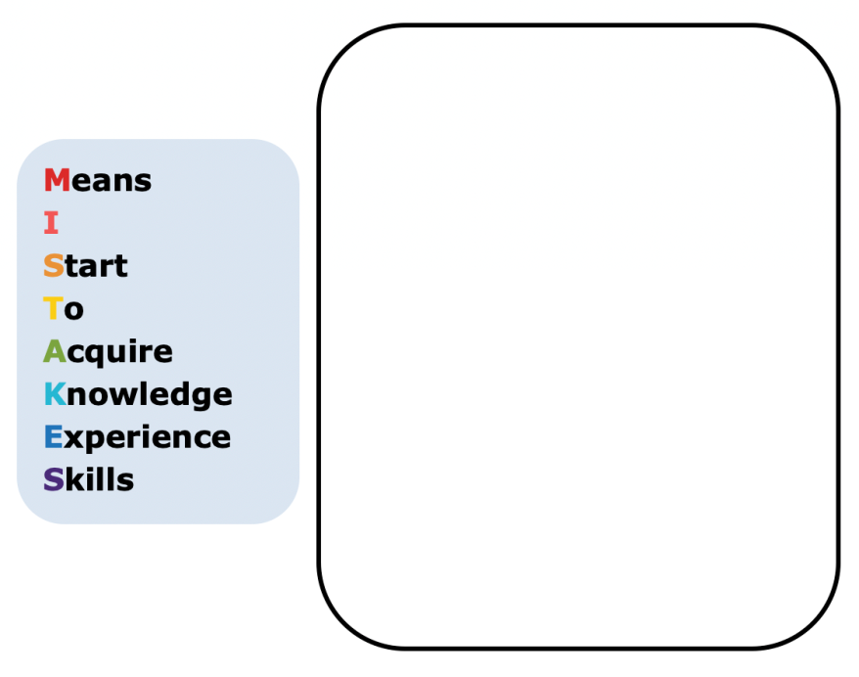
5.3.4 Wrap-Up: Growth Mindset
Mistakes are an opportunity to learn. Complete the statement to highlight a mistake you learned from.
My favorite mistake from today was …
volume 1, pg. 243

